Slide 1


Lecture 5 Type Parameterisation, Pattern Matching & Variance
12.3.2023
Iflaah Salman

Slide 2
Type Parameterisation
We are already familiar with type parameterisation
in the collection types where
A List can be parameterised to hold only Strings, Person objects or integers.
We now, look at how we can create our own types that are
generic and
can be parameterised by concrete type.
The generic class and type parameterisation
provide a powerful construct for creating type-safe and reusable code.
We can create generic Classes and Traits as both can be instantiated with a concrete type. But, not generic Objects as we cannot instantiate an Object (this is handled for us by Scala at runtime).

Slide 3
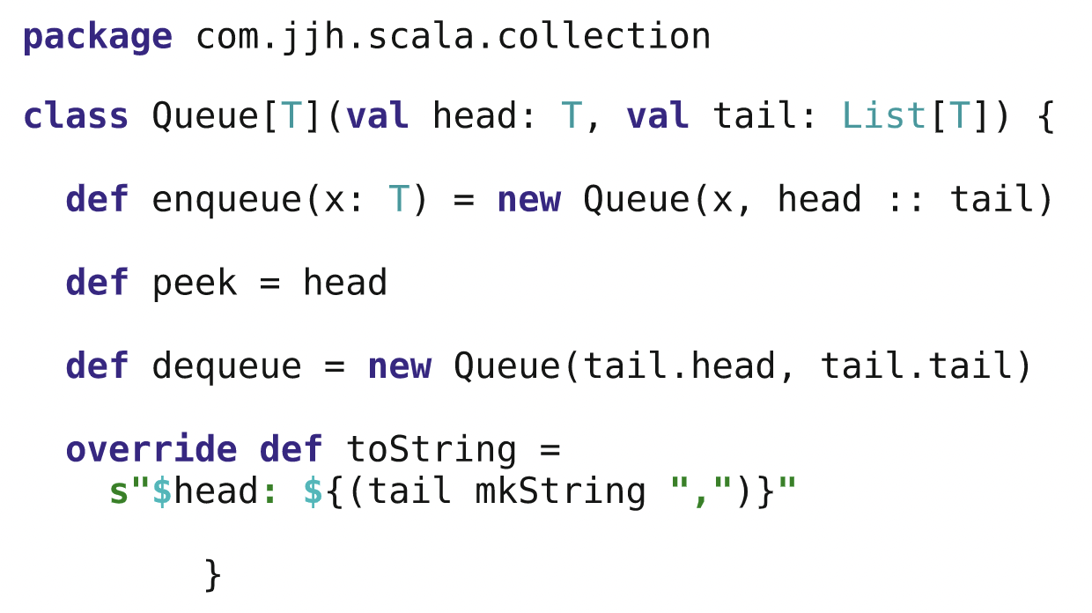
Type Parameterisation
By convention, the letter ‘T’ is used to indicate a type to specify.
The immutable Queue Class with parameters into the primary constructor
head passed into Queue is of type T and the tail is a list of type T.
The class creates a new Queue when a value is enqueued.
Returns a new Queue (with the current head removed) in response to a dequeue.
The class provides a peek method to see what is currently at the head of the queue.
This class is used in exactly the same way as one of the built-in collection classes.
Notes:
Can I add different datatypes into a generic queue?

Slide 4
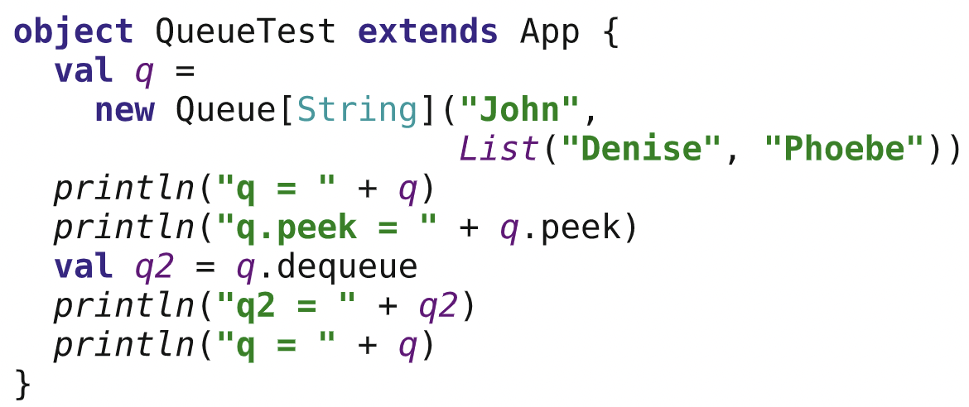
Type Parameterisation
‘T’ has been replaced within the instance of the Queue class by the concrete type String.
The type of the parameter X in the enqueue method is String as is the type returned by the dequeue method.
We can actually create a Queue parameterised by Int, Boolean, Double or any user-defined type such as Person.
Notes:
Can I add different datatypes into a generic queue?

Slide 5
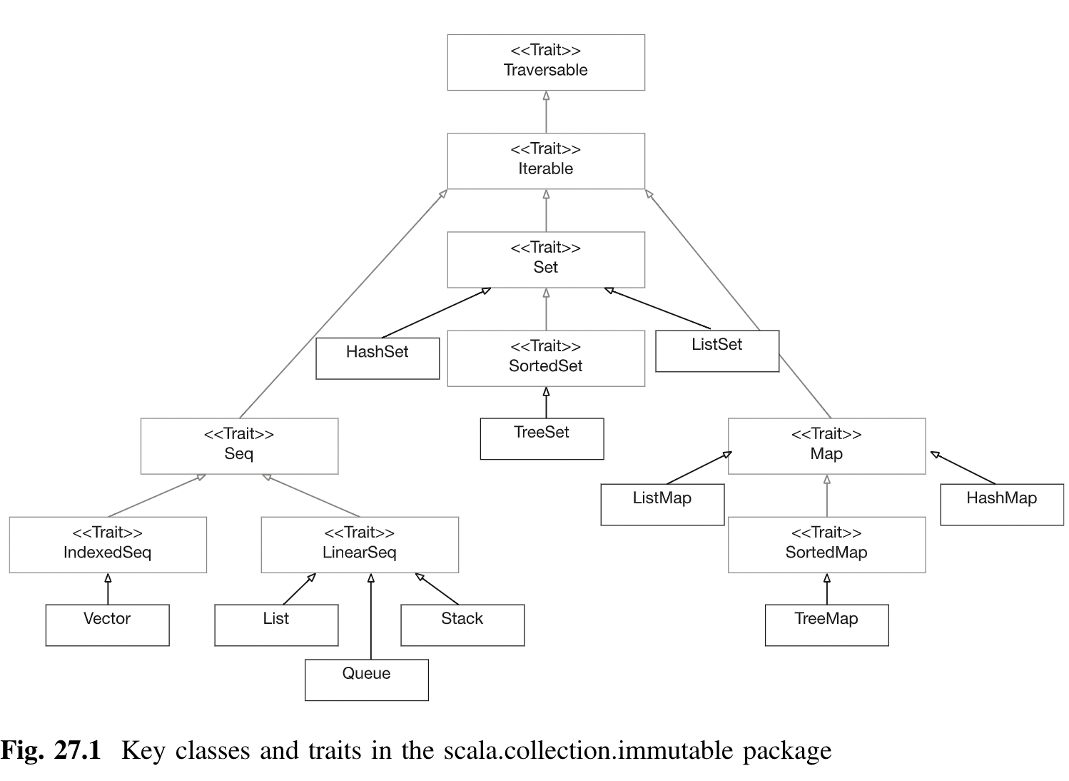
Trait
Traits can play in developing reusable behaviour that simplifies the development of new types.

Slide 6
Variance
If we have a Set that can hold Persons (Set[Person] - parent type), should it be able to hold references to instances of the class Employee (Set[Employee]– subtype) if it is a subtype of Person?
This situation is referred to as variance and within a type system, in a programming language, a type rule is:
Covariant if it preserves the ordering of types from more specific to more generic.
Contravariant if it reverses the ordering.
Invariant if neither of these applies.
In Scala, by default, we are not able to do so. But, we can address this limitation with the help of variance annotations.

Slide 7
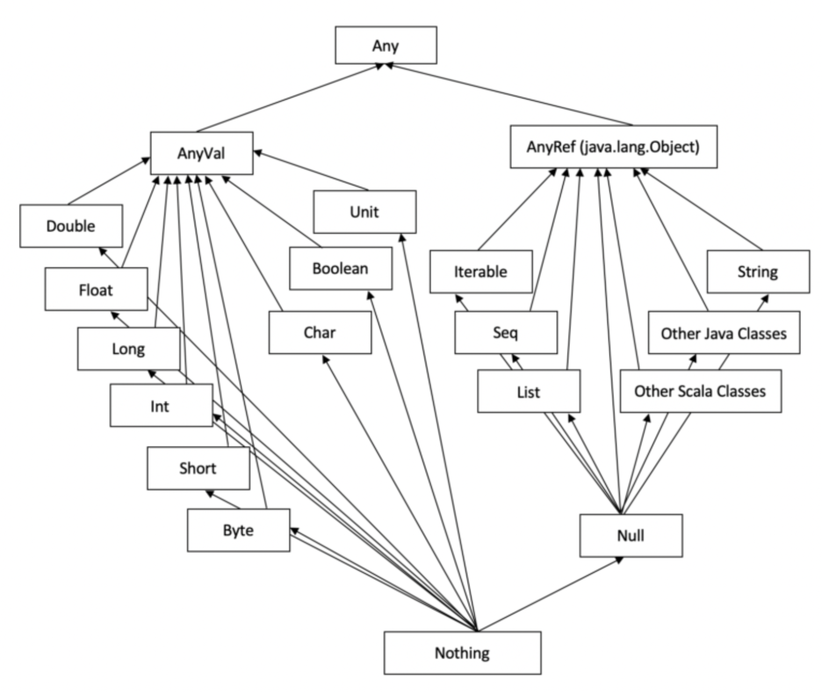
Variance
We can define our generic types to be
covariant or
contravariant
For example:
Queue[+ T](...){...} indicates covariant where Queue[String] is considered a subtype of Queue[AnyRef]
Queue[−T](...){...} indicates contravariance where Queue[AnyRef] would be considered a supertype of Queue[String].
We are declaring the Queue data type to be polymorphic in the type of elements it contains.
https://www.baeldung.com/scala/type-hierarchies
Notes:
In Scala, Any is a supertype of all classes and types.
Nothing is a subtype of all types.

Slide 8
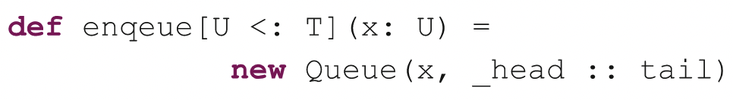
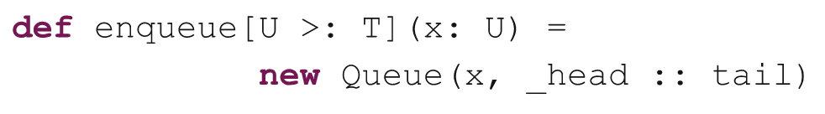
Lower and Upper Bounds
We use lower bound on the type specification to limit the types that can be used for T or any supertype of T.
When we enqueue an item then the type of this item must be of type T or a super type of T.
if we have a queue of Employees this would allow us to enqueue a Person to the Queue (although the resulting Queue only guarantee that it holds references to Person objects (or subtypes of Person).
If you want to limit the types
that can be used with T or
any subclass of T
then you can use an upper bound!

Slide 9
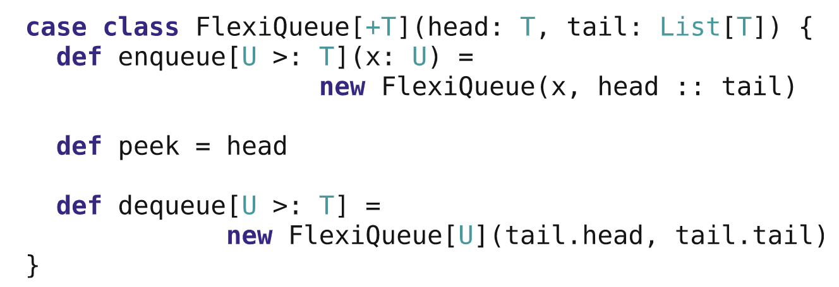
Combining Variance and Bounds
We can combine variance and bounds together for flexible containers.
FlexiQueue class indicates that type T indicates covariance.
the methods enqueue and dequeue have lower bounds: the type T and its super types may be used with these methods.
If we create a FlexiQueue of Employees and then subsequently enqueue a Person this will return a FlexiQueue of Person types.

Slide 10
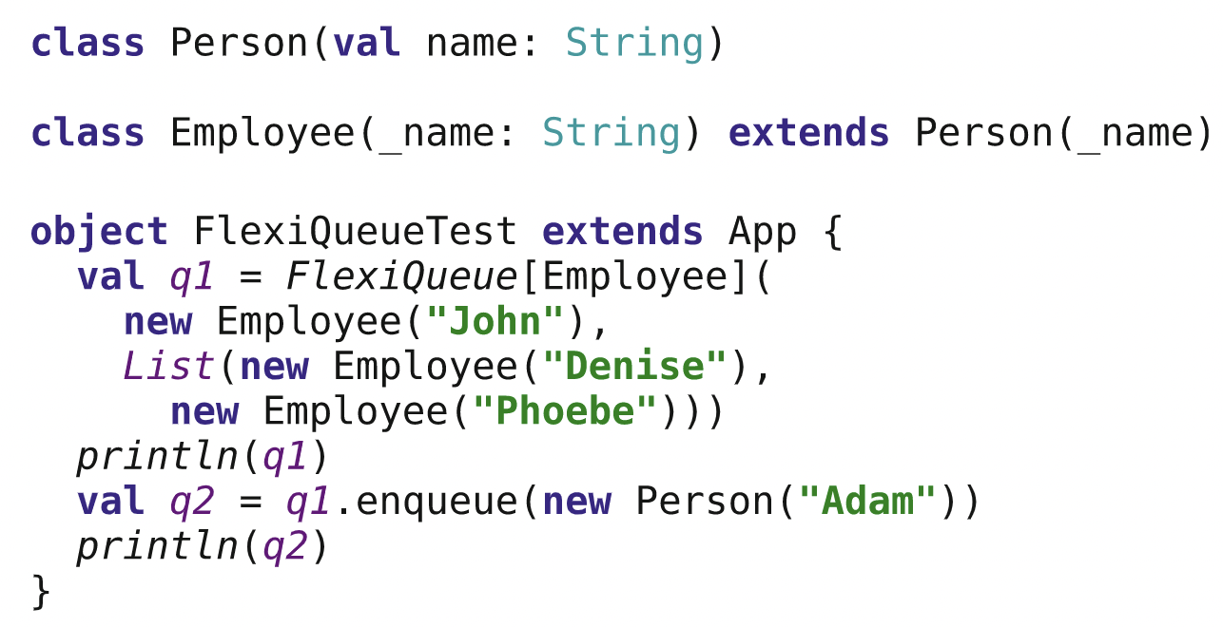
Combining Variance and Bounds
Type inferred by Scala for q1 and q2:
q1 holds a reference to a FlexiQueue[Employee] type of instance.
q2 holds a reference to a FlexiQueue[Person] type of instance.
Once we added a Person to the FlexiQueue, the only thing we could now guarantee is that the contents of the queue are now at least Person instance.
The type to be used should be a Person or a subtype of Person.

Slide 11
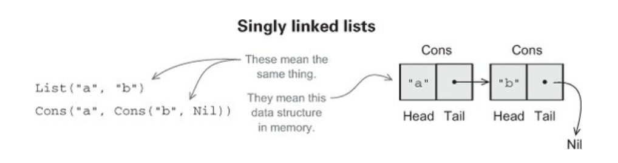
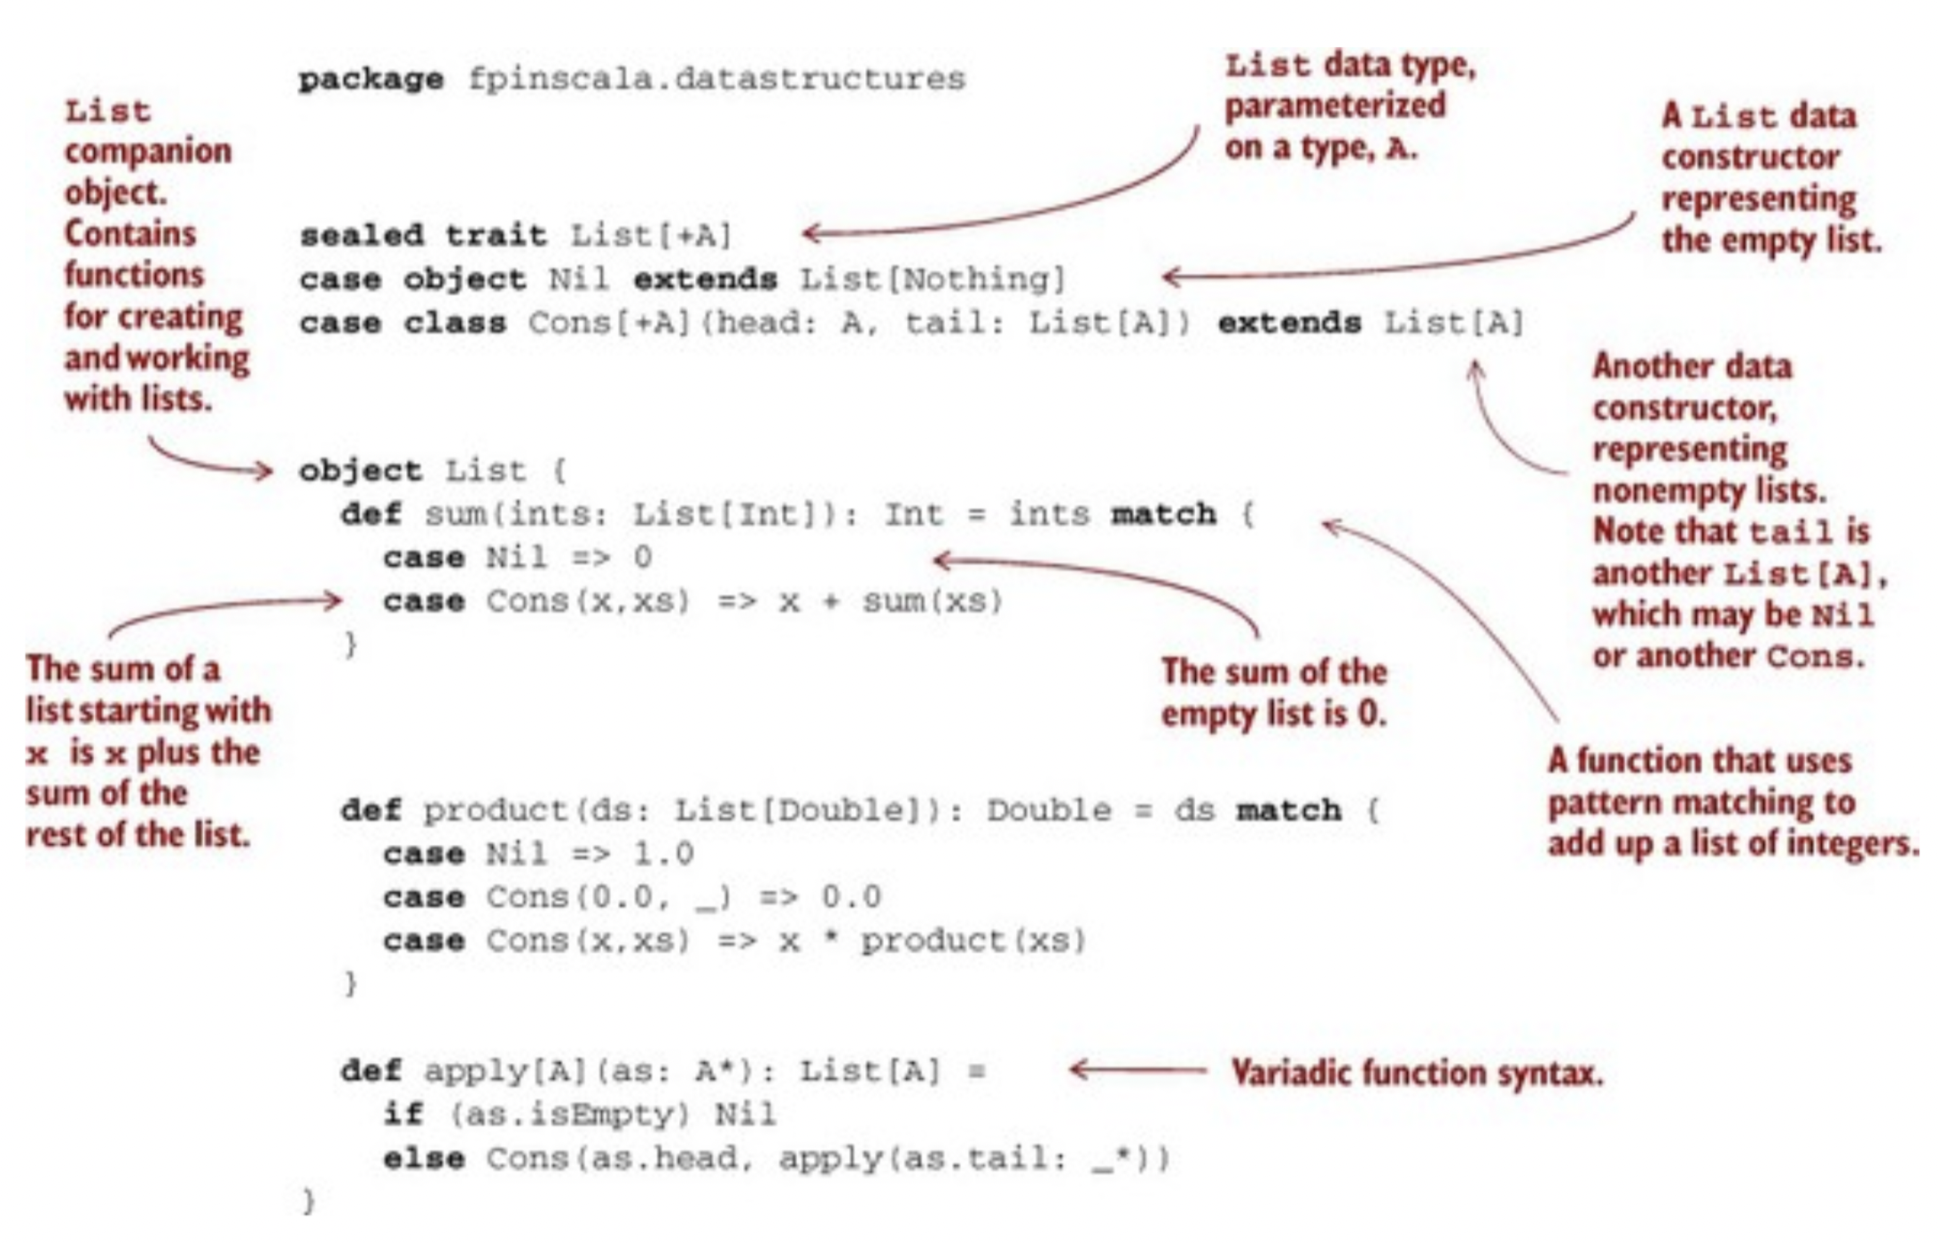
A trait is an abstract interface that may optionally contain implementations of some methods.
Object Nil lets us write Nil to construct an empty List
Adding sealed in front means that all implementations of the trait must be declared in this file.
Two implementations (data constructors) or two possible forms a List can take; empty (Nil) or non-empty (Cons).
A companion object in addition to our data type and its data constructors. This is just an object with the same name as the data type (in this case List) where we put various convenience functions for creating or working with values of the data type.
Notes:
But, in this piece of code, we do not have any methods on the trait List.
Nil can be instantiated with type List[Double], which is allowed because the empty list contains no elements and can be considered a list of whatever type we want!

Slide 12
Pattern Matching
Pattern matching works a bit like a fancy switch statement.
case class Person(name: String, age: Int) val bob = Person("Bob", 43) // Person.apply("Bob", 43) val personGreeting = bob match { case Person(n, a) => s"Hi, my name is $n and I am $a years old." case _ => "Something else" }
val anInteger = 55 val order = anInteger match { case 1 => "first" case 2 => "second" case 3 => "third" case _ => anInteger + "th" }
val aList = List(1,2,3) val listDescription = aList match { case List(_, 2, _) => "List containing 2 on its second position" case _ => "unknown list" }
Source: rockthejvm
Notes:
55th
Hi, my name is Bob and I am 43 years old.
List containing 2 on its second position.

Slide 13
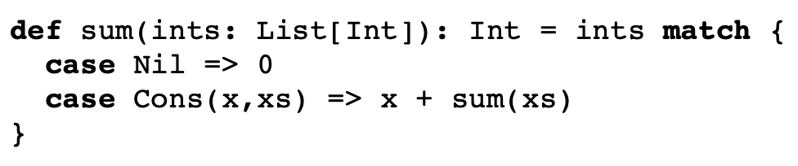
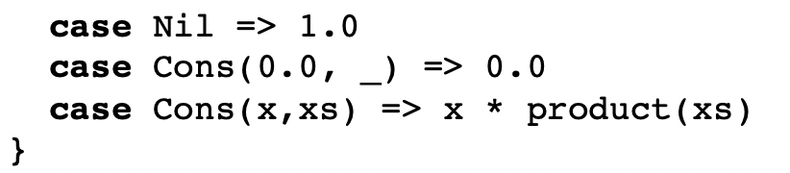
Pattern Matching
Pattern matching works a bit like a fancy switch statement.
the sum of a nonempty list is the first element, x, plus the sum of the remaining elements, xs.
product definition states that the product of an empty list is 1.0, the product of any list starting with 0.0 is 0.0, and the product of any other nonempty list is the first element multiplied by the product of the remaining elements.
These are recursive definitions/methods
Known as target or scrutinee.
Each case in the match consists of a pattern (like Cons(x,xs)) to the left of the => and a result (like x * product(xs)) to the right of the =>.
If the target matches the pattern in a case, the result of that case becomes the result of the entire match expression.
If multiple patterns match the target, Scala chooses the first matching case.

Slide 14
Pattern Matching!
List(1,2,3) match { case _ => 42 }
Here we’re using a variable pattern, _, which matches any expression. We could say x or foo instead of _, but we usually use _ to indicate a variable whose value we ignore in the result of the case.
List(1,2,3) match { case Cons(h , _ ) => h }
Here we’re using a data constructor pattern in conjunction with variables to capture or bind a subexpression of the target.
List(1,2,3) match { case Cons( _ , t) => t }
List(1,2,3) match { case Nil => 42 }
Notes:
42
1
List(2,3)
MatchError at runtime. A MatchError indicates that none of the cases in a match expression matched the target.

Slide 15

References
Hunt, J. (2018). A Beginner’s Guide to Scala, Object Orientation and Functional Programming. In A Beginner’s Guide to Scala, Object Orientation and Functional Programming. Springer International Publishing. https://doi.org/10.1007/978-3-319-75771-1
Chiusano, P., & Bjarnason, R. (2014). Functional Programming in Scala. Manning publications.

